Slide 1

Cloud Native Application
Cloud Foundry and Microservices
Derrick Wong
Notes:
Thanks for taking your time to listen to all of us, and me while you’re eating. I’ll try not to make anyone choke, too hard.
I’m going to give you some orientation around CD and microservices. These are two vitally important concepts - cultures - for understadning Pivotal’s deal if you will: how we think we can help you.

Slide 2

Microservices Overview

Slide 3
DEFINE: Microservice
If every service has to be updated in concert, it’s not loosely coupled!
Loosely coupled service oriented
architecture with bounded contexts
If you have to know about surrounding services you don’t have a bounded context.
Adrian Cockcroft, Former Netflix Chief Cloud Architect
Notes:
Loosely coupled: Stand-alone. Can come up and down without effecting or needing other components.
Bounded contexts: How your data is managed. Data models that care about the semantics of the context they’re in. Products, meters, 17 reservations. Not perfect
Example: Notification Service knows that is has to deliver a message when there is an event.

Slide 4



Monolithic Architecture
HTML
JavaScript
MVC
Service
Service
Data Access
Browser
Monolithic Application
Relational Database
Notes:
Large, monolithic enterprise relational DB a layered, monolithic architecture, delivered to the browser.

Slide 5
Monolithic Architectures
Complex
Modularity Dependent Upon Language / Frameworks
Change Cycles Tightly Coupled / Obstacle to Frequent Deploys
Inefficient Scaling
Can Be Intimidating to New Developers
Obstacle to Scaling Development
Requires Long-Term Commitment to Technical Stack

Slide 6
Monolithic Architectures
Catalog
User
Registration
Search
Orders
Profile
Account
Recommendation
Lists

Slide 7
Scaling Monolithic Architectures
Catalog
User
Registration
Catalog
User
Registration
Catalog
User
Registration
Catalog
User
Registration
Catalog
User
Registration
Catalog
User
Registration
Catalog
User
Registration
Catalog
User
Registration
Search
Orders
Profile
Search
Orders
Profile
Search
Orders
Profile
Search
Orders
Profile
Search
Orders
Profile
Search
Orders
Profile
Search
Orders
Profile
Search
Orders
Profile
Account
Recommendation
Lists
Account
Recommendation
Lists
Account
Recommendation
Lists
Account
Recommendation
Lists
Account
Recommendation
Lists
Account
Recommendation
Lists
Account
Recommendation
Lists
Account
Recommendation
Lists

Slide 8
Linear scalability?

Slide 9




Microservice Architecture
Relational
DB
HTTP
HTTP
Key/Value
Store
HTTP
HTTP
HTTP
…
AMQP
AMQP
HTTP
Graph
DB
Notes:
REST and message-driven services
Polyglot persistence, services encapsulate data store semantics
Diversity of clients acknowledged
API Gateway for service aggregation, reduce chattiness, protocol translation, reduce latency/round-trips, deal with mobile device fragmentation, build use case/device specific API’s

Slide 10
Microservice Architectures
Simple
Modularity Based on Component Services
Change Cycles Decoupled / Enable Frequent Deploys
Efficient Scaling
Individual Components Less Intimidating to New Developers
Enables Scaling of Development
Eliminates Long-Term Commitment to Technical Stack

Slide 11
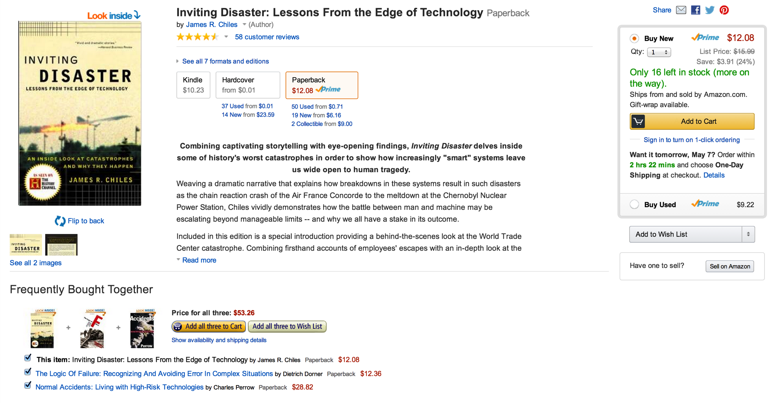

How many microservices?
ELEVEN

Slide 12
All teams will henceforth expose their data and functionality through service interfaces.
Teams must communicate with each other through these interfaces.
There will be no other form of inter-process communication allowed: no direct linking, no direct reads of another team’s data store, no shared-memory model, no back-doors whatsoever. The only communication allowed is via service interface calls over the network.
It doesn’t matter what technology they use.
All service interfaces, without exception, must be designed from the ground up to be externalizable. That is to say, the team must plan and design to be able to expose the interface to developers in the outside world. No exceptions.
http://apievangelist.com/2012/01/12/the-secret-to-amazons-success-internal-apis/
Notes:
Anyone who doesn’t do this will be fired. Thank you; have a nice day! Everyone got to work and over the next couple of years, Amazon transformed itself, internally into a service-oriented architecture (SOA), learning a tremendous amount along the way.

Slide 13
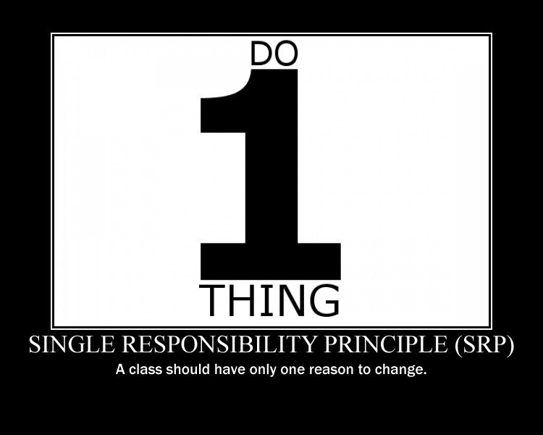
Partitioning Strategies

Slide 14
Challenges of Microservices
Distributed System
Remote Calls More Expensive Than In-process Calls
Eventual Consistency
Features Spanning Multiple Services
Dependency Management / API Versioning
Refactoring Module Boundaries
Notes:
running more numerous/diverse things, more operations overhead
devops skills required to deliver environments and backing services
compiler can’t help us with module integration
how do we (or do we even) attempt to share libraries?
distributed systems are hard
asynchronous interactions (common in microservices as you’ll see) are harder than synchronous ones
testing all of this is harder!

Slide 15

You must be this tall
to use Microservices…
Rapid provisioning
Basic monitoring
Rapid application deployment
DevOps culture
https://www.flickr.com/photos/gusset/3723961589
Source: “Microservice Prerequisites,” Martin Fowler, August 2014.
Notes:
have to be able to spin up new application environments and backing services quickly
monitoring needed b/c distributed systems hard to test exhaustively
have to be able to deploy apps quickly to respond to discoveries in monitoring
requires the type of cross-cutting interactions we talked about in the continuous delivery section

Slide 16

Platform Features
Environment Provisioning
On-Demand/Automatic Scaling
Failover/Resilience
Routing/Load Balancing
Data Service Operations
Monitoring
Notes:
So what do we want out of the platform and how does CF do it?
That’s what we just covered in Adam’s presentation.

Slide 17

Pattern:
Configuration/Service Consumption

Slide 18

What is configuration?
Resource handles to databases and other backing services
Credentials to external sources (e.g. S3, Twitter, ...)
Per-deploy values (e.g. canonical hostname for deploy)
ANYTHING that’s likely to vary between deploys (dev, test, stage, prod)
Notes:
… Where should you put configuration?

Slide 19
Where NOT to store it:
In the CODE (Obvious)
In PROPERTIES FILES (That’s code...)
In the BUILD (ONE build, MANY deploys)
In the APP SERVER (e.g. JNDI datasources)
Notes:
… How about environment variables?

Slide 20
Why environment variables?
When “...the codebase could be made open source at any moment, without compromising any credentials.”
http://12factor.net/config
Notes:
You know you’re done when …
Easy to change
Little chance of being “checked in” to VCS
Language/OS-agnostic standard
Supported in PCF of course

Slide 21
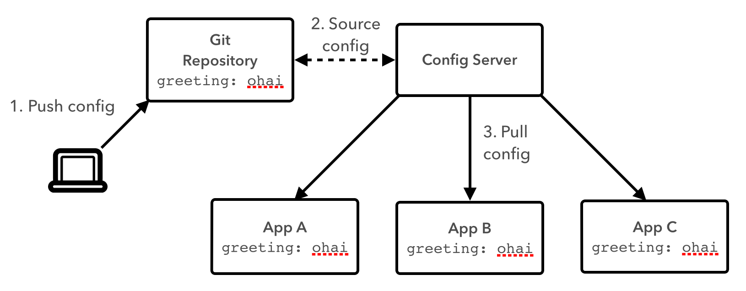
Config Server
Notes:
But when you have a lot of config == lots of env variables, how do you manage them across environments?

Slide 22
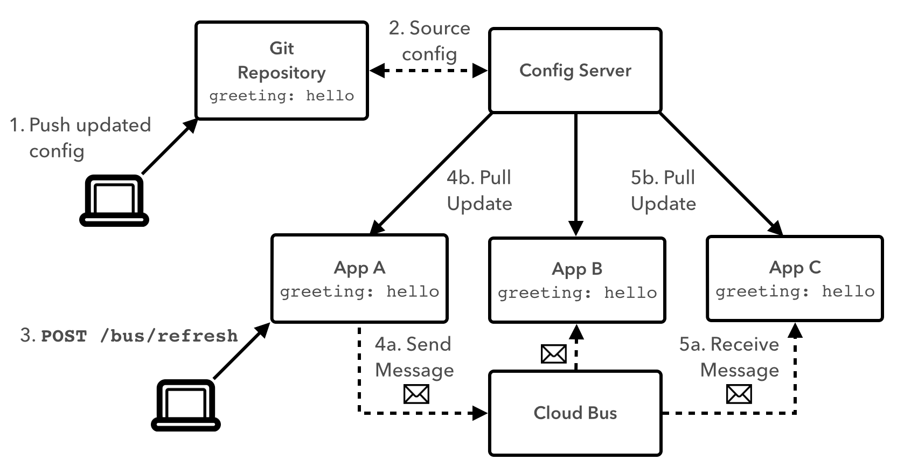
Config Server + Cloud Bus
Notes:
Configuration can also be updated at runtime…

Slide 23

But no Microservice is an Island…

Slide 24
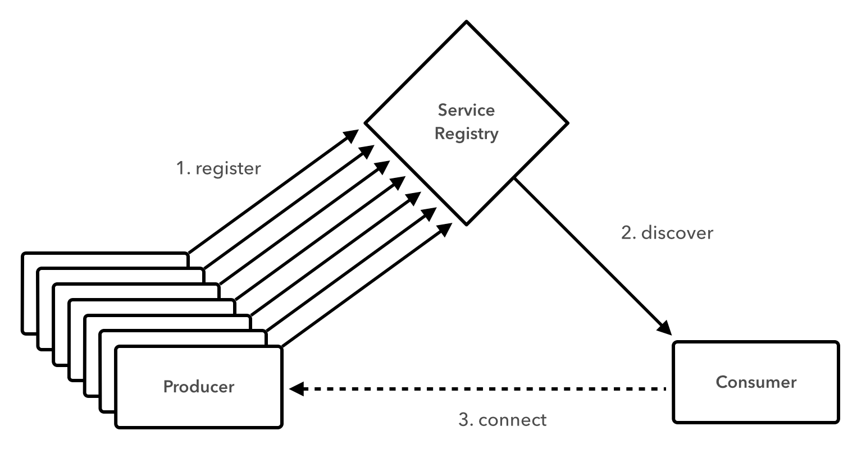
Service Registration/Discovery

Slide 25
Service Registration/Discovery
@SpringBootApplication
@EnableCircuitBreaker
@EnableDiscoveryClient
public class CustomerApp extends RepositoryRestMvcConfiguration {
@Override
protected void configureRepositoryRestConfiguration(RepositoryRestConfiguration config) {
config.exposeIdsFor(Customer.class);
}
public static void main(String[] args) {
SpringApplication.run(CustomerApp.class, args);
}
}

Slide 26

Pattern:
Fault Tolerance

Slide 27

Fault Tolerance at Netflix
http://techblog.netflix.com/2012/02/fault-tolerance-in-high-volume.html

Slide 28
Without taking steps to ensure fault tolerance, 30 dependencies each with 99.99% uptime would result in 2+ hours downtime/month (99.99%³⁰ = 99.7% uptime = 2+ hours downtime in a month).
http://techblog.netflix.com/2012/02/fault-tolerance-in-high-volume.html
Notes:
99.99% uptime = approximately 4 minutes of downtime per month

Slide 29
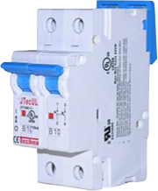
Circuit Breaker

Slide 30
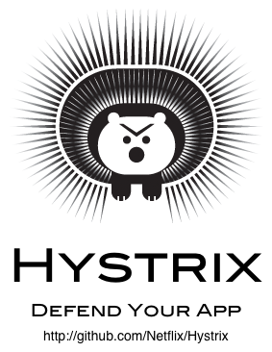
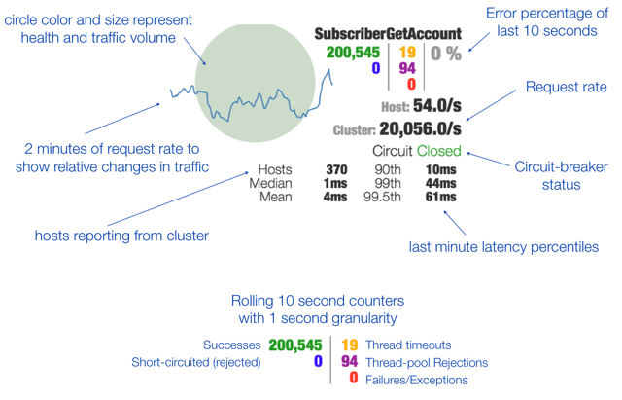
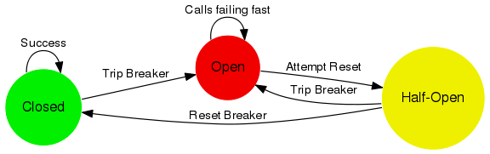
Resilience
Resilient
On large distributed systems, failures are a norm and not an exception, be ready for that.

Slide 31

Hystrix Dashboard

Slide 32
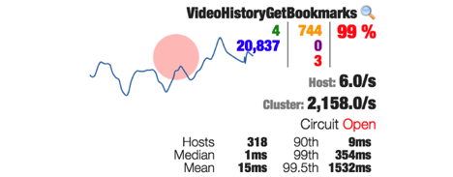
A Failing Circuit

Slide 33
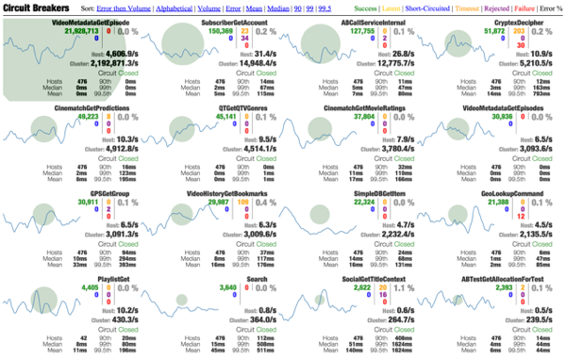


Putting it all together
Turbine
Dashboard
Feeds

Slide 34

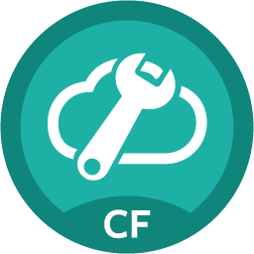


Spring Cloud Services Suite
Spring Cloud Services
Config Server
Service Registry
Circuit Breaker
Dashboard
Notes:
This is stuff we have tiles for
Ribbon and Hystrix are really client libraries – hence no tile.
This is what’s in the box for 1.0 –
Service Registry: Eureka (not any others, need something that “just works” for devs
Config Server – can use SVN, Git
Circuit Breaker – Hystrix Dashboard + turbine.

Slide 35
It takes a platform…
Cloud Foundry
Spring Cloud
Services

Slide 36
Spring Cloud Services Suite
Installed via Pivotal Ops Manager
Adds all services to Pivotal Cloud Foundry Marketplace
Dependencies:
MySQL for PCF
RabbitMQ for PCF
Public Beta: May 2015
Spring Cloud
Services
Notes:
ONE CLICK INSTALL
1 config server AI
2 AIs for eureka (for F/T)
2 Ais for Turbine
1 SI for turbine (Rabbit perhaps for pub/sub to hystrix dashboard?)
1 SI for svc broker (mysql) for config server?

Slide 37
Spring Cloud Config Server
Spring Cloud Config Server
Service Binding via Spring Cloud Connector
Git/SVN URL for Config Repo provided via Service Dashboard (post-provisioning)
Single tenant, scoped to CF space (nothing prevents shared Git repo)
Config Server

Slide 38
Spring Cloud Service Registry
Service Registration and Discovery via Netflix OSS Eureka
Service Binding via Spring Cloud Connector
Single-tenant, scoped to CF space
Registration via CF Route
PCF 1.5: Support Direct Address (“promiscuous”) Mode
Service Registry

Slide 39
Spring Cloud Services Suite
Netflix OSS Turbine + Hystrix Dashboard
Aggregation via AMQP (RabbitMQ)
Binding via Spring Cloud Connector
Single-tenant, scoped to CF space
Circuit Breaker
Dashboard

